Slide 2
solve various problems relating to boats and streams.

Slide 3
Problem 1
The speed of a boat in still water is 30 Km/h. If the speed of the stream be 5 Km/h, then find out downstream and upstream speeds of boat.
Downstream Speed of Boat, x = (a + b) Km/h
Upstream Speed of Boat, y = (a - b) Km/h
Speed of Boat, a = 30 Km/h & Speed of Stream, b = 5 Km/h
Downstream Speed of Boat, x = (30 + 5) Km/h = 35 Km/h
Upstream Speed of Boat, y = (30 - 5) Km/h = 25 Km/h

Slide 4
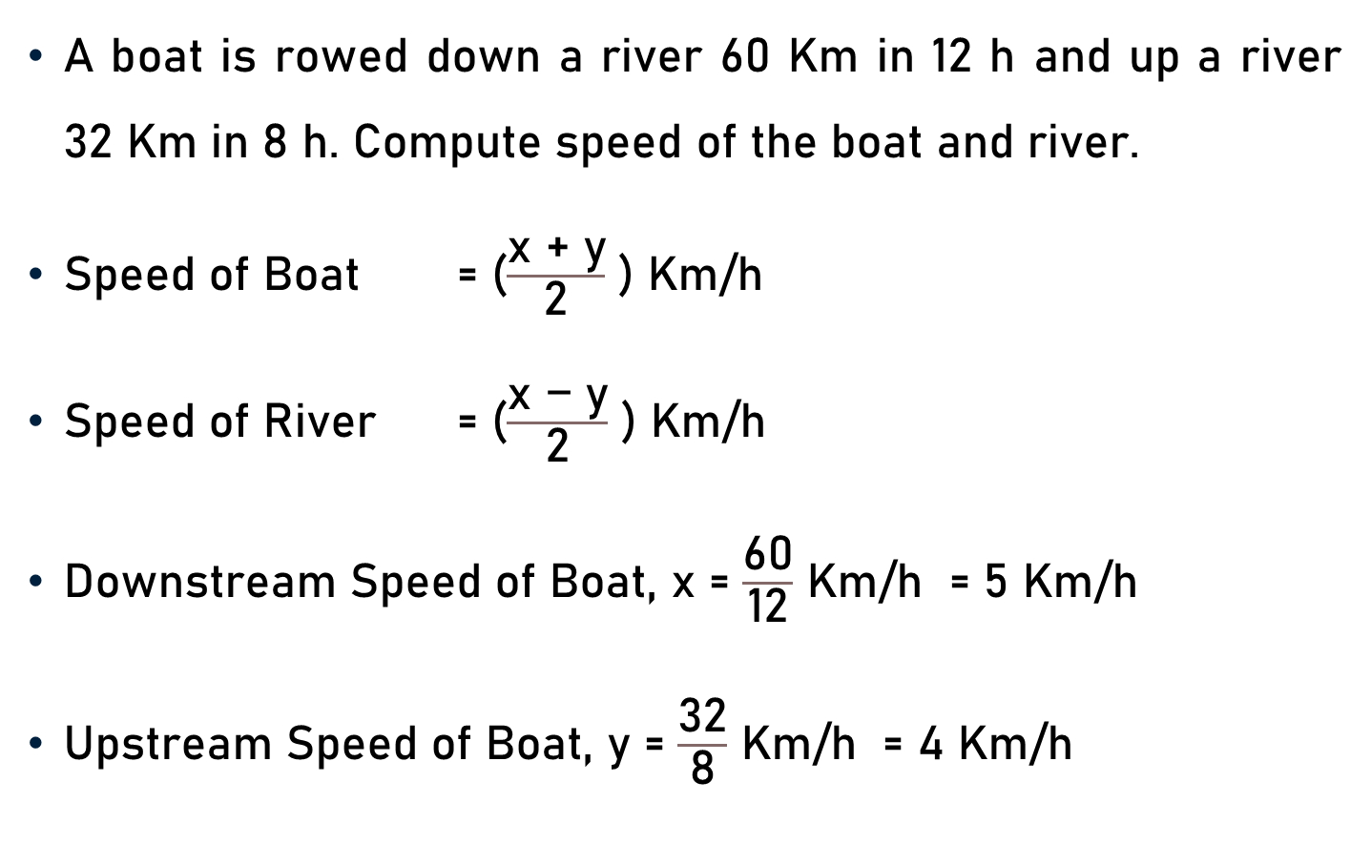
Problem 2
A boat is rowed down a river 60 Km in 12 h and up a river 32 Km in 8 h. Compute speed of the boat and river.
Speed of Boat = ($\frac{\text{x}\text{ + }\text{y}}{\text{2}}$ ) Km/h
Speed of River = ($\frac{\text{x}\text{ − }\text{y}}{\text{2}}$ ) Km/h
Downstream Speed of Boat, x = $\frac{\text{60}}{\text{1}\text{2}}$ Km/h = 5 Km/h
Upstream Speed of Boat, y = $\frac{\text{32}}{\text{8}}$ Km/h = 4 Km/h
5
4

Slide 5
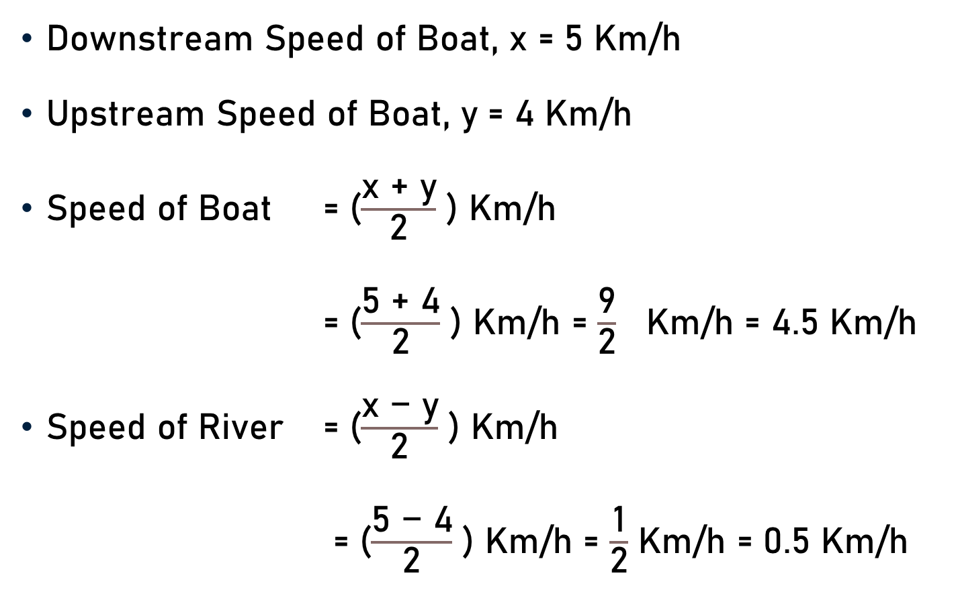
Problem 2
Downstream Speed of Boat, x = 5 Km/h
Upstream Speed of Boat, y = 4 Km/h
Speed of Boat = ($\frac{\text{x}\text{ + }\text{y}}{\text{2}}$ ) Km/h
= ($\frac{\text{5}\text{ + }\text{4}}{\text{2}}$ ) Km/h = $\frac{\text{9}}{\text{2}}$ Km/h = 4.5 Km/h
Speed of River = ($\frac{\text{x}\text{ − }\text{y}}{\text{2}}$ ) Km/h
= ($\frac{\text{5}\text{ − }\text{4}}{\text{2}}$ ) Km/h = $\frac{\text{1}}{\text{2}}$ Km/h = 0.5 Km/h
4.5

Slide 6
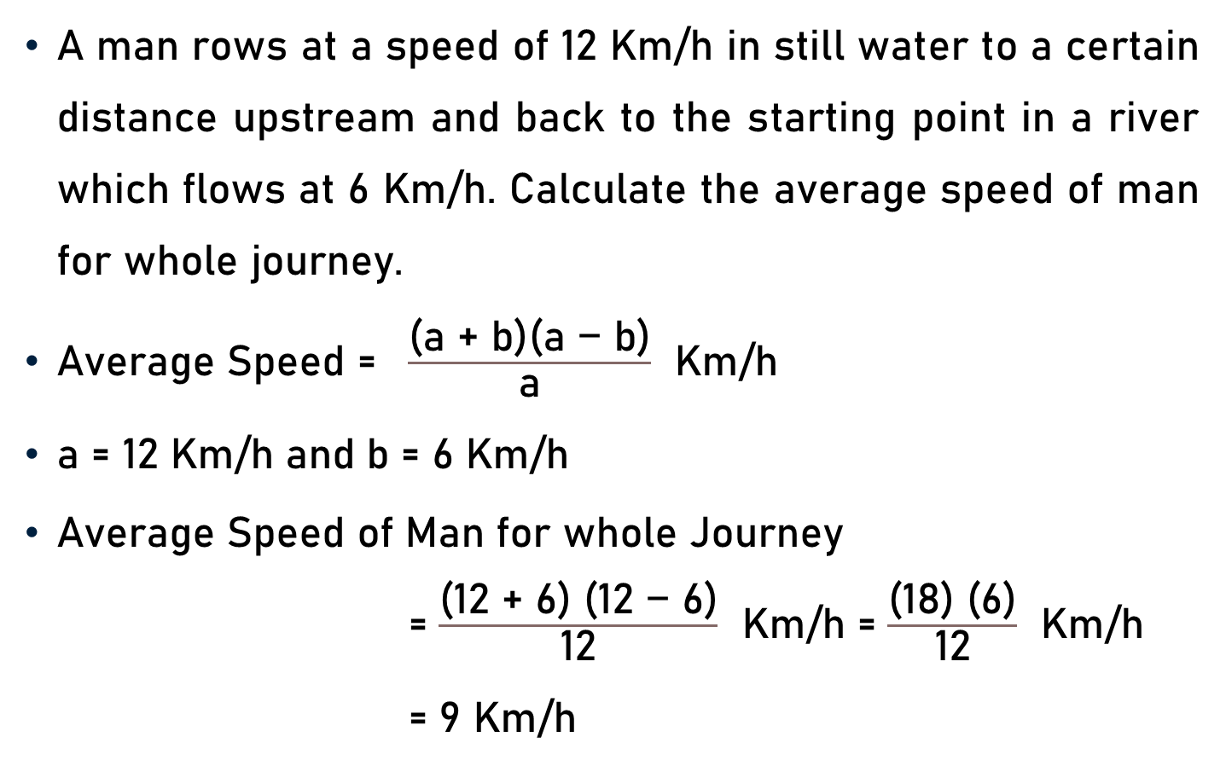
Problem 3
A man rows at a speed of 12 Km/h in still water to a certain distance upstream and back to the starting point in a river which flows at 6 Km/h. Calculate the average speed of man for whole journey.
Average Speed = $\frac{\text{(}\text{a}\text{ + }\text{b}\text{)(}\text{a}\text{ − }\text{b}\text{)}}{\text{a}}$ Km/h
a = 12 Km/h and b = 6 Km/h
Average Speed of Man for whole Journey
= $\frac{\text{(}\text{12}\text{ + }\text{6}\text{) (}\text{12}\text{ − }\text{6}\text{)}}{\text{12}}$ Km/h = $\frac{\text{(}\text{18}\text{) (}\text{6}\text{)}}{\text{12}}$ Km/h
= 9 Km/h
9
2

Slide 7
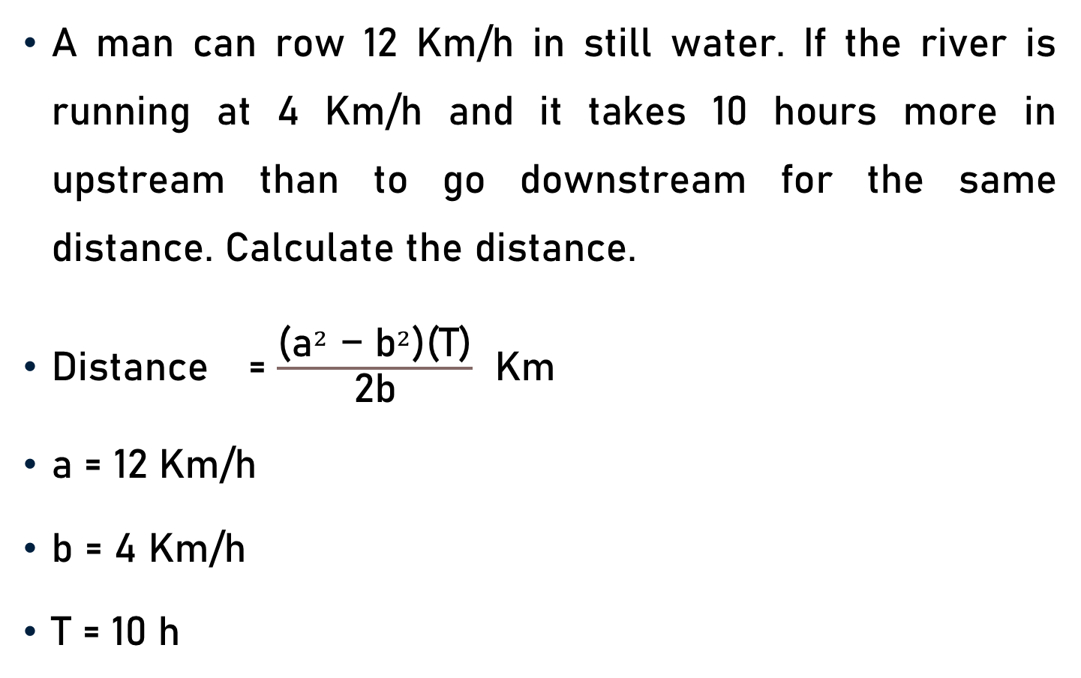
Problem 4
A man can row 12 Km/h in still water. If the river is running at 4 Km/h and it takes 10 hours more in upstream than to go downstream for the same distance. Calculate the distance.
Distance = $\frac{\text{(}{\text{a}}^{2}\text{ − }{\text{b}}^{2}\text{)}\text{(}\text{T}\text{)}}{\text{2}\text{b}}$ Km
a = 12 Km/h
b = 4 Km/h
T = 10 h

Slide 8
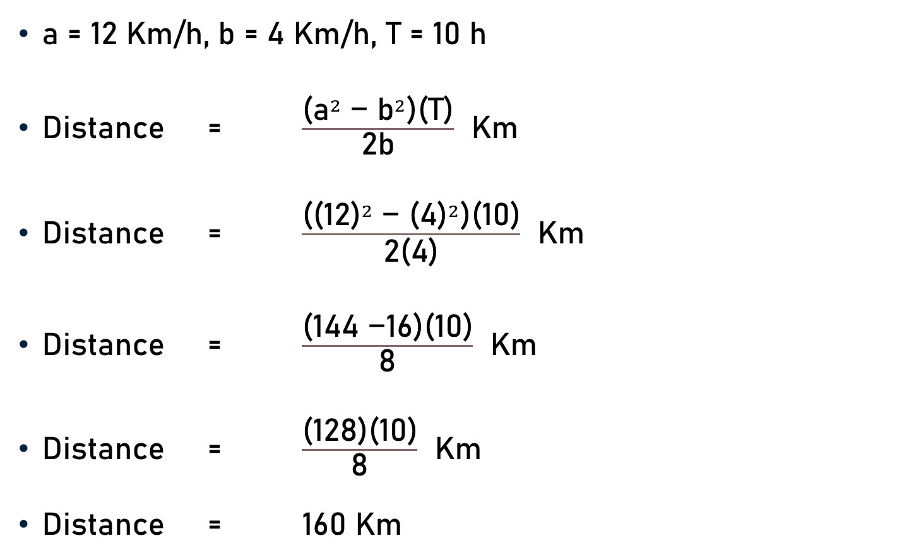
Problem 4
a = 12 Km/h, b = 4 Km/h, T = 10 h
Distance = $\frac{\text{(}{\text{a}}^{2}\text{ − }{\text{b}}^{2}\text{)}\text{(}\text{T}\text{)}}{\text{2}\text{b}}$ Km
Distance = $\frac{\text{(}{\text{(12)}}^{2}\text{ − }{\text{(4)}}^{2}\text{)}\text{(}\text{10}\text{)}}{\text{2}\text{(4)}}$ Km
Distance = $\frac{\text{(}\text{1}\text{44 }\text{−}\text{1}\text{6}\text{)}\text{(}\text{10}\text{)}}{\text{8}}$ Km
Distance = $\frac{\text{(}\text{12}\text{8}\text{)}\text{(}\text{10}\text{)}}{\text{8}}$ Km
Distance = $\text{1}\text{60 }$Km
16

Slide 9
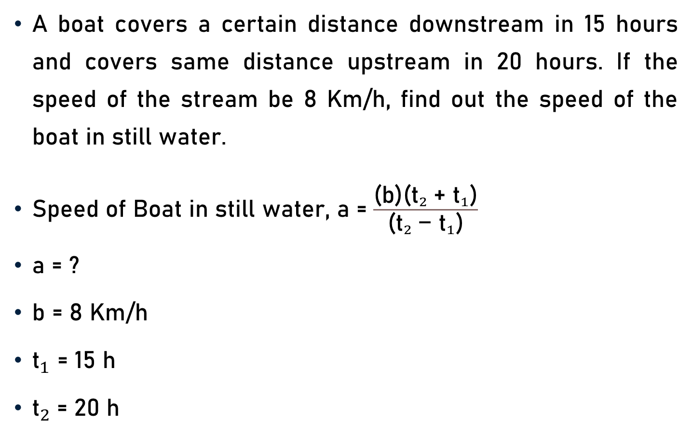
Problem 5
A boat covers a certain distance downstream in 15 hours and covers same distance upstream in 20 hours. If the speed of the stream be 8 Km/h, find out the speed of the boat in still water.
Speed of Boat in still water, $\text{a}$= $\frac{\text{(}\text{b}\text{)(}{{\text{t}}_{2} \text{+ }\text{t}}_{1}\text{)}}{\text{(}{{\text{t}}_{2} \text{− }\text{t}}_{1}\text{)}}$
a = ?
b = 8 Km/h
${\text{t}}_{1}$ = 15 h
${\text{t}}_{2}$= 20 h

Slide 10
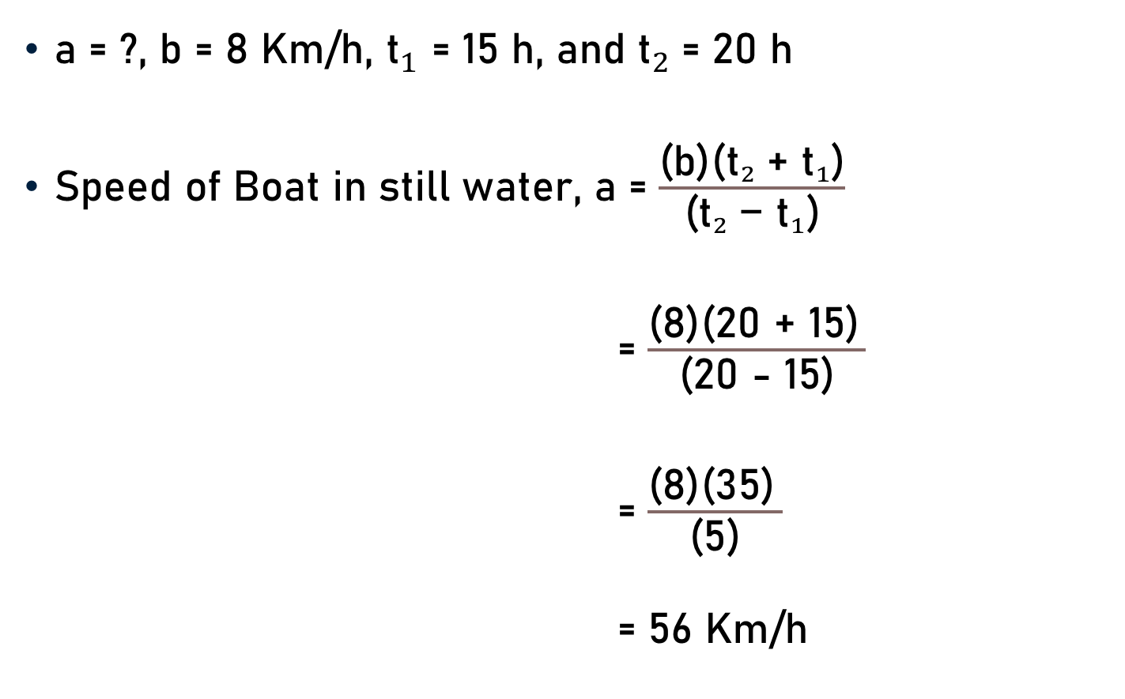
Problem 5
a = ?, b = 8 Km/h, ${\text{t}}_{1}$ = 15 h, and ${\text{t}}_{2}$= 20 h
Speed of Boat in still water, $\text{a}$= $\frac{\text{(}\text{b}\text{)(}{{\text{t}}_{2} \text{+ }\text{t}}_{1}\text{)}}{\text{(}{{\text{t}}_{2} \text{− }\text{t}}_{1}\text{)}}$
= $\frac{\text{(}\text{8}\text{)(}\text{20} \text{+}\text{ 15}\text{)} }{\text{(}\text{20} \text{−} \text{15}\text{)}}$
= $\frac{\text{(}\text{8}\text{)(}\text{35}\text{)} }{\text{(}\text{5}\text{)}}$
= 56 Km/h
7

Slide 11
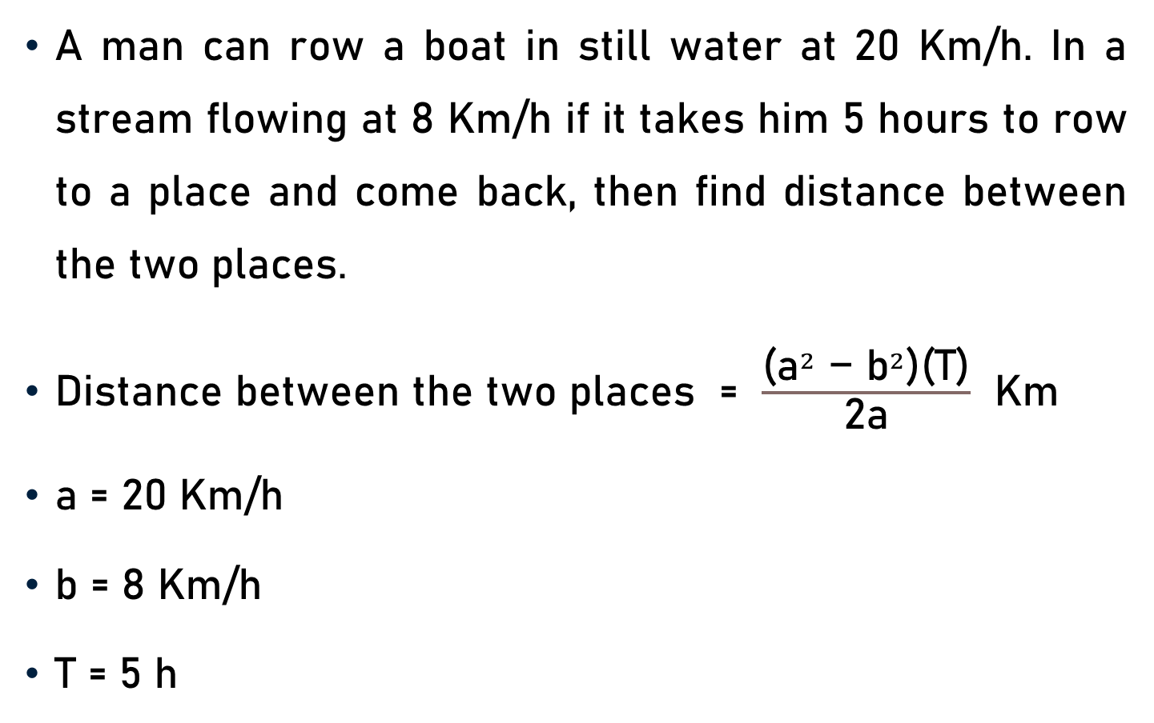
Problem 6
A man can row a boat in still water at 20 Km/h. In a stream flowing at 8 Km/h if it takes him 5 hours to row to a place and come back, then find distance between the two places.
Distance between the two places = $\frac{\text{(}{\text{a}}^{2}\text{ − }{\text{b}}^{2}\text{)}\text{(}\text{T}\text{)}}{\text{2}\text{a}}$ Km
a = 20 Km/h
b = 8 Km/h
T = 5 h

Slide 12
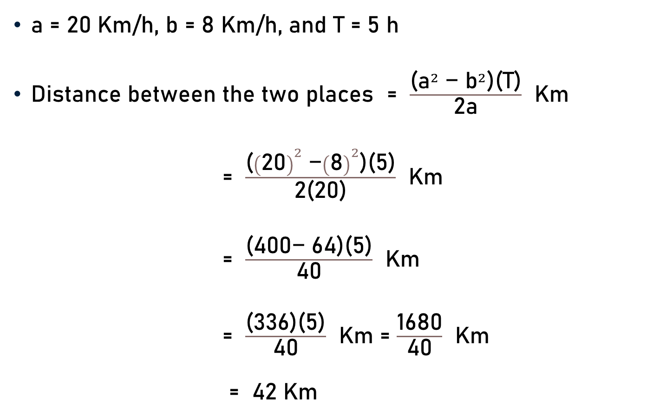
Problem 6
a = 20 Km/h, b = 8 Km/h, and T = 5 h
Distance between the two places = $\frac{\text{(}{\text{a}}^{2}\text{ − }{\text{b}}^{2}\text{)}\text{(}\text{T}\text{)}}{\text{2}\text{a}}$ Km
= $\frac{\text{(}{\left(\text{20}\right)}^{2}\text{ −}{\left(\text{8}\right)}^{2}\text{)}\text{(}\text{5}\text{)}}{\text{2}\text{(20)}}$ Km
= $\frac{\text{(}\text{400}\text{−}\text{ 64}\text{)}\text{(}\text{5)}}{\text{4}\text{0}}$ Km
= $\frac{\text{(}\text{3}\text{36}\text{)}\text{(}\text{5)}}{\text{40}}$ Km = $\frac{\text{1}\text{6}\text{80}}{\text{40}}$ Km
= $\text{42}$ Km
42

Slide 13
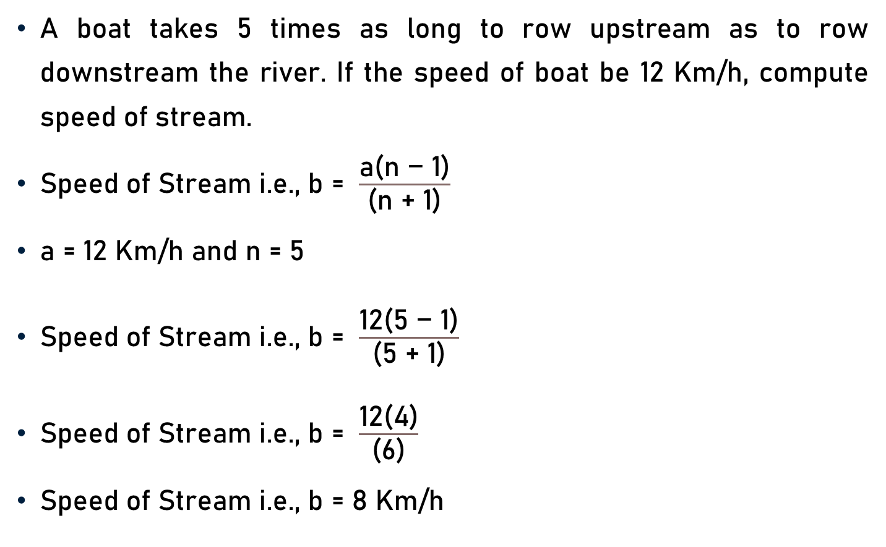
Problem 7
A boat takes 5 times as long to row upstream as to row downstream the river. If the speed of boat be 12 Km/h, compute speed of stream.
Speed of Stream i.e., b = $\frac{\text{a}\text{(}\text{n}\text{ − 1}\text{)}}{\text{(}\text{n}\text{ + 1}\text{)}}$
a = 12 Km/h and n = 5
Speed of Stream i.e., b = $\frac{\text{12}\text{(}\text{5}\text{ − 1}\text{)}}{\text{(}\text{5}\text{ + 1}\text{)}}$
Speed of Stream i.e., b = $\frac{\text{12}\text{(}\text{4}\text{)}}{\text{(}\text{6}\text{)}}$
Speed of Stream i.e., b = $\text{8 }\text{Km}\text{/}\text{h}$
2

Slide 14
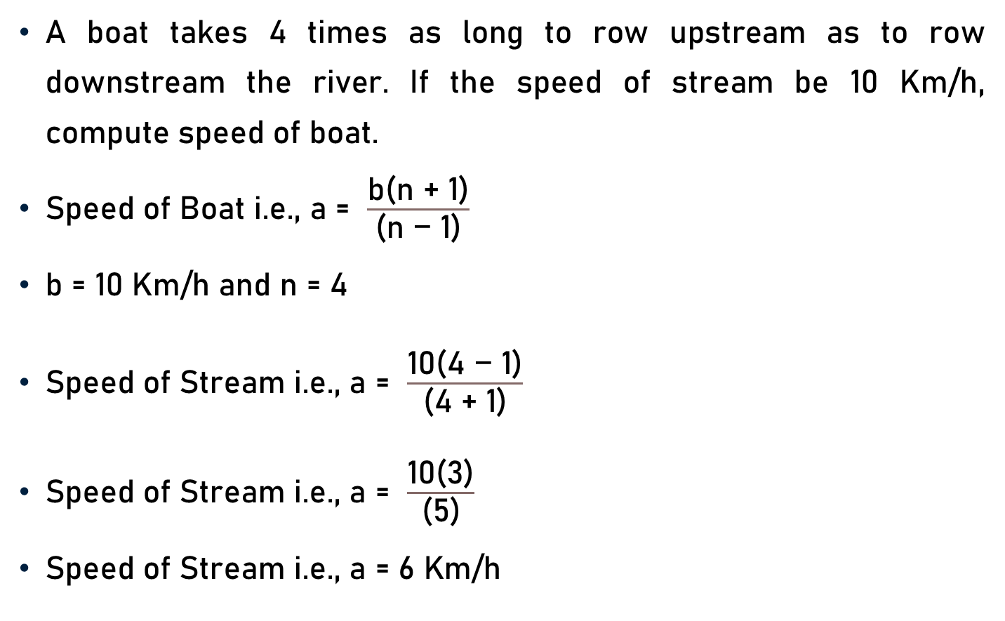
Problem 8
A boat takes 4 times as long to row upstream as to row downstream the river. If the speed of stream be 10 Km/h, compute speed of boat.
Speed of Boat i.e., a = $\frac{\text{b}\text{(}\text{n}\text{ + 1}\text{)}}{\text{(}\text{n}\text{ − 1}\text{)}}$
b = 10 Km/h and n = 4
Speed of Stream i.e., a = $\frac{\text{10}\text{(}\text{4}\text{ − 1}\text{)}}{\text{(}\text{4}\text{ + 1}\text{)}}$
Speed of Stream i.e., a = $\frac{\text{1}\text{0}\text{(}\text{3}\text{)}}{\text{(}\text{5}\text{)}}$
Speed of Stream i.e., a = $\text{6 }\text{Km}\text{/}\text{h}$
2

Slide 15
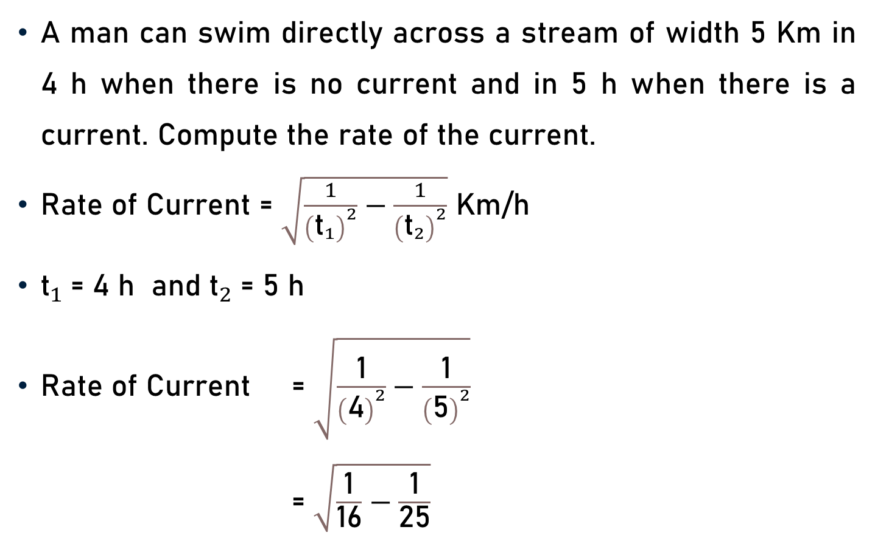
Problem 9
A man can swim directly across a stream of width 5 Km in 4 h when there is no current and in 5 h when there is a current. Compute the rate of the current.
Rate of Current = $\sqrt{\frac{1}{{\left({\text{t}}_{1}\right)}^{2}}−\frac{1}{{\left({\text{t}}_{2}\right)}^{2}}}$ Km/h
${\text{t}}_{1}$= 4 h and ${\text{t}}_{2}$= 5 h
Rate of Current = $\sqrt{\frac{\text{1}}{{\left(\text{4}\right)}^{2}}−\frac{\text{1}}{{\left(\text{5}\right)}^{2}}}$
= $\sqrt{\frac{\text{1}}{\text{16}}−\frac{\text{1}}{\text{25}}}$

Slide 16

Problem 9
Rate of Current = $\sqrt{\frac{\text{1}}{\text{16}}−\frac{\text{1}}{\text{25}}}$
= $\sqrt{\frac{\text{25}\text{ − 1}\text{6} }{\text{(}\text{16)(25)} }}$ = $\sqrt{\frac{\text{9}}{ \text{(}\text{1}\text{6)(25)}}}$
= $\frac{\text{3}}{ \text{(}\text{4}\text{)(5)}}$
= $\frac{\text{3}}{ \text{(}\text{20}\text{)}}$
= 0.15 Km/h

Slide 17
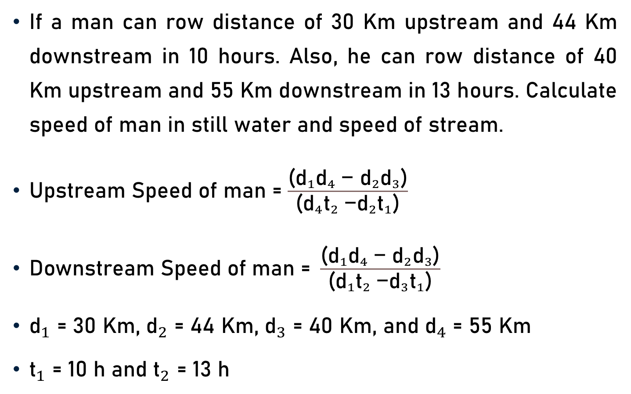
Problem 10
If a man can row distance of 30 Km upstream and 44 Km downstream in 10 hours. Also, he can row distance of 40 Km upstream and 55 Km downstream in 13 hours. Calculate speed of man in still water and speed of stream.
Upstream Speed of man = $\frac{\text{(}{{{\text{d}}_{1}\text{d}}_{4} \text{− }{\text{d}}_{2}\text{d}}_{3}\text{)}}{\text{(}{{{\text{d}}_{4}\text{t}}_{2} \text{−}{\text{d}}_{2}\text{t}}_{1}\text{)}}$
$\text{Downstream} \text{Speed} \text{of} \text{man}\text{ = }\frac{\text{(}{{{\text{d}}_{1}\text{d}}_{4} \text{− }{\text{d}}_{2}\text{d}}_{3}\text{)}}{\text{(}{{{\text{d}}_{1}\text{t}}_{2} \text{−}{\text{d}}_{3}\text{t}}_{1}\text{)}}$
${\text{d}}_{1}$ = 30 Km, ${\text{d}}_{2}$ = 44 Km, ${\text{d}}_{3}$ = 40 Km, and ${\text{d}}_{4}$ = 55 Km
${\text{t}}_{1}$ = 10 h and ${\text{t}}_{2}$ = 13 h

Slide 18
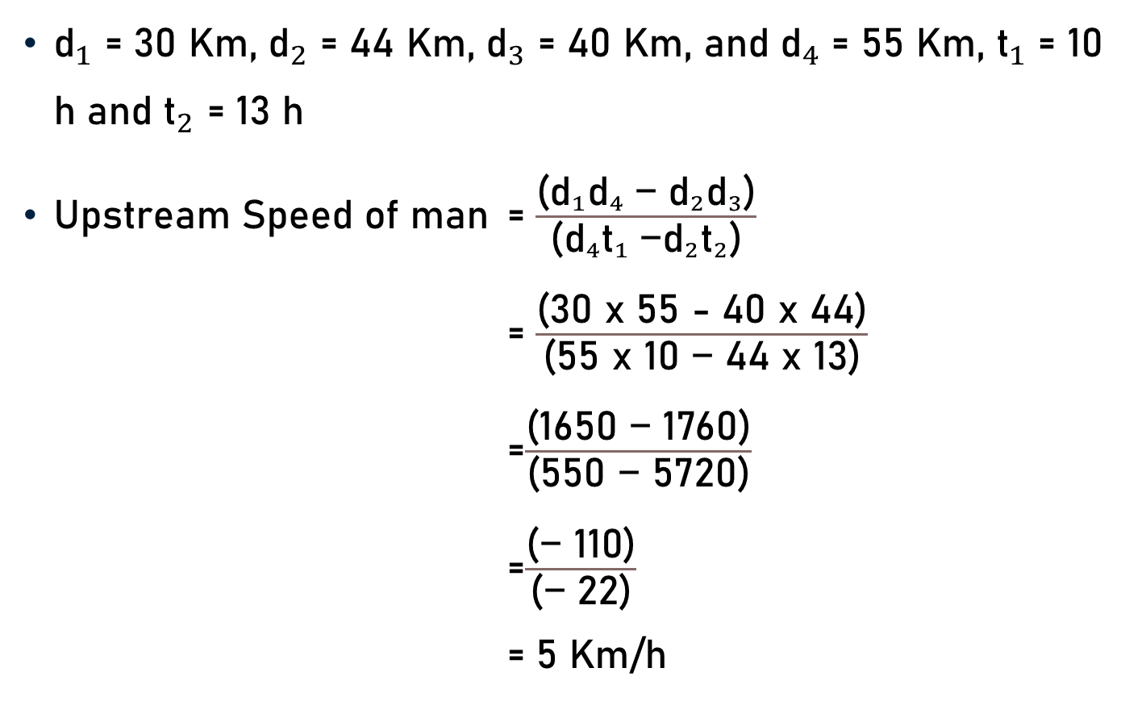
Problem 10
${\text{d}}_{1}$ = 30 Km, ${\text{d}}_{2}$ = 44 Km, ${\text{d}}_{3}$ = 40 Km, and ${\text{d}}_{4}$ = 55 Km, ${\text{t}}_{1}$ = 10 h and ${\text{t}}_{2}$ = 13 h
Upstream Speed of man = $\frac{\text{(}{{{\text{d}}_{1}\text{d}}_{4} \text{− }{\text{d}}_{2}\text{d}}_{3}\text{)}}{\text{(}{{{\text{d}}_{4}\text{t}}_{1} \text{−}{\text{d}}_{2}\text{t}}_{2}\text{)}}$
= $\frac{\text{(}\text{3}\text{0 }\text{x}\text{ 55 − 40 }\text{x}\text{ 44}\text{)}}{\text{(}\text{55} \text{x}\text{ 10 − 44 }\text{x}\text{ 13}\text{)}}$
=$\frac{\text{(}\text{165}\text{0 − }\text{1760}\text{)}}{\text{(}\text{55}\text{0 − }\text{572}\text{0}\text{)}}$
=$\frac{\text{(}\text{− }\text{110}\text{)}}{\text{(}\text{− }\text{22}\text{)}}$
= 5 Km/h
5

Slide 19
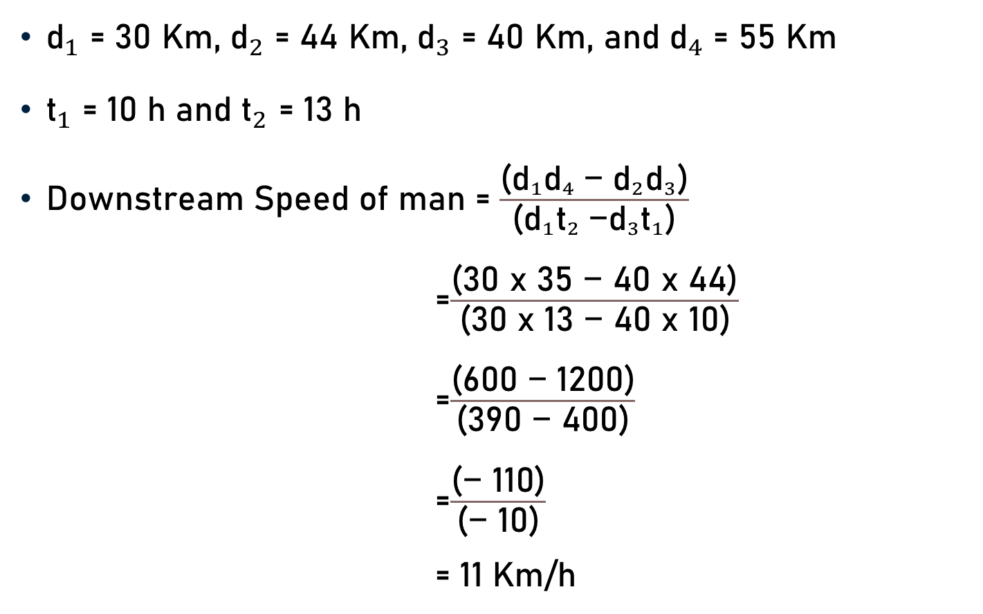
Problem 10
${\text{d}}_{1}$ = 30 Km, ${\text{d}}_{2}$ = 44 Km, ${\text{d}}_{3}$ = 40 Km, and ${\text{d}}_{4}$ = 55 Km
${\text{t}}_{1}$ = 10 h and ${\text{t}}_{2}$ = 13 h
Downstream Speed of man = $\frac{\text{(}{{{\text{d}}_{1}\text{d}}_{4} \text{− }{\text{d}}_{2}\text{d}}_{3}\text{)}}{\text{(}{{{\text{d}}_{1}\text{t}}_{2} \text{−}{\text{d}}_{3}\text{t}}_{1}\text{)}}$
=$\frac{\text{(}\text{3}\text{0 }\text{x}\text{ 35 − 40 }\text{x}\text{ 44}\text{)}}{\text{(}\text{3}\text{0 }\text{x}\text{ 13 − 40 }\text{x}\text{ 10}\text{)}}$
=$\frac{\text{(}\text{6}\text{00 − 1200}\text{)}}{\text{(}\text{390}\text{ − }\text{40}\text{0}\text{)}}$
=$\frac{\text{(}\text{− }\text{11}\text{0}\text{)}}{\text{(}\text{− }\text{1}\text{0}\text{)}}$
= 11 Km/h
11

Slide 20
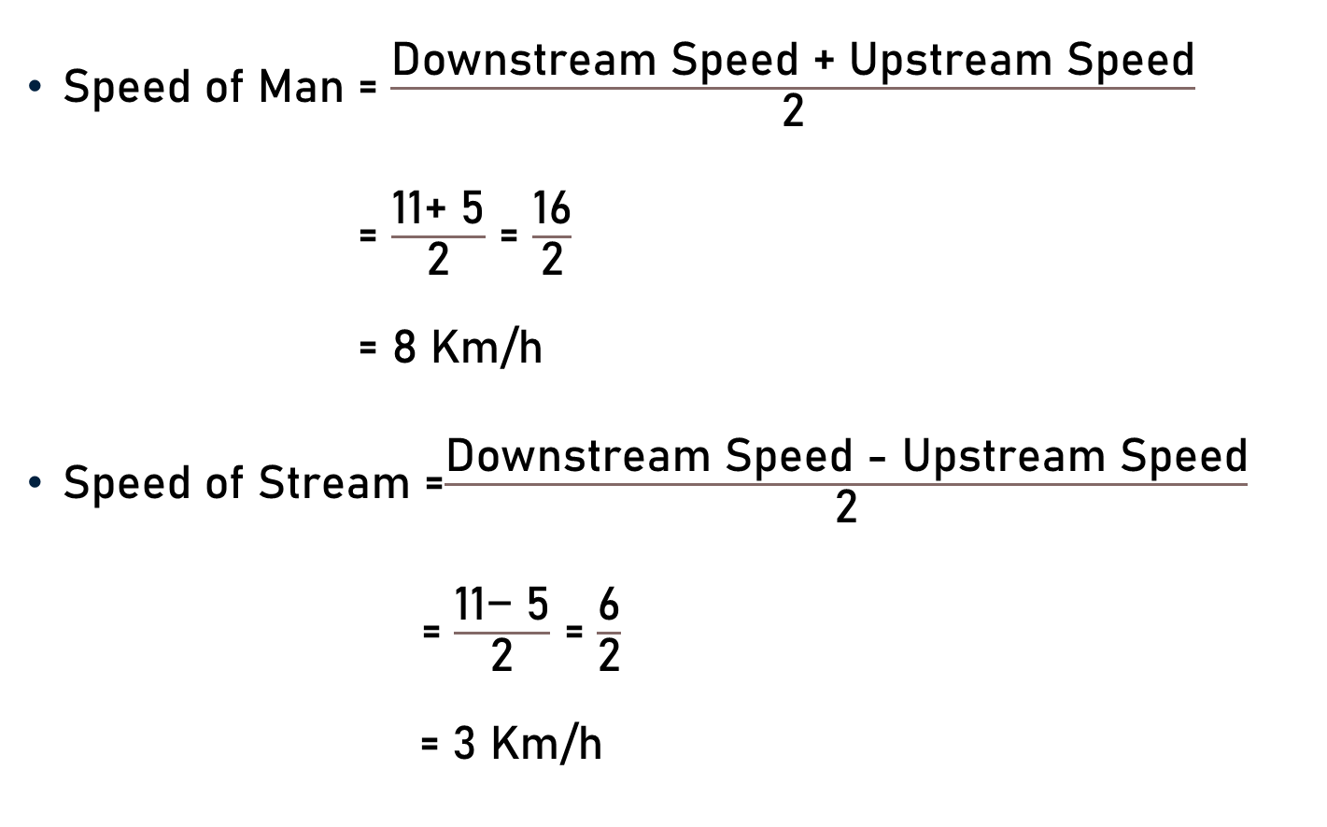
Problem 10
Speed of Man = $\frac{\text{Downstream} \text{Speed}\text{ + }\text{Upstream} \text{Speed}}{\text{2}}$
= $\frac{\text{11}\text{+ }\text{5}}{\text{2}}$ = $\frac{\text{1}\text{6}}{\text{2}}$
= 8 Km/h
Speed of Stream =$\frac{\text{Downstream} \text{Speed}\text{ − }\text{Upstream} \text{Speed}}{\text{2}}$
= $\frac{\text{11}\text{− }\text{5}}{\text{2}}$ = $\frac{\text{6}}{\text{2}}$
= 3 Km/h
8
3

Slide 21
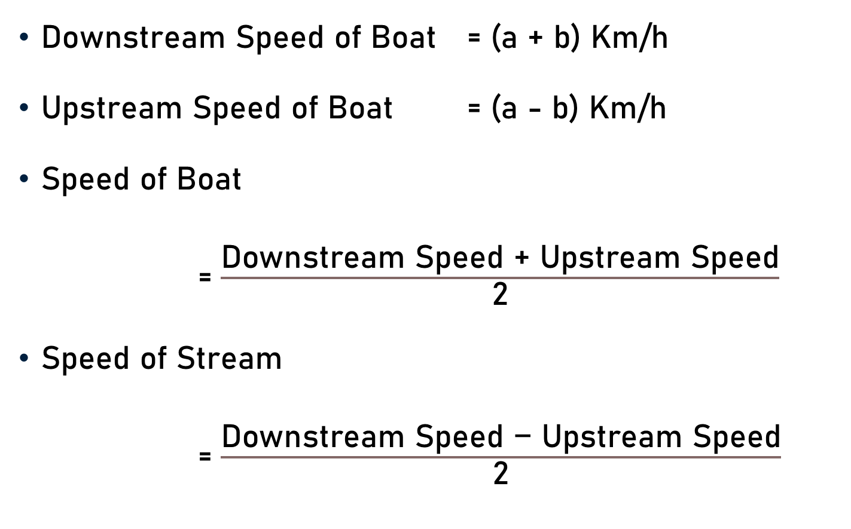
Conclusion
Downstream Speed of Boat = (a + b) Km/h
Upstream Speed of Boat = (a - b) Km/h
Speed of Boat
= $\frac{\text{Downstream} \text{Speed}\text{ + }\text{Upstream} \text{Speed}}{\text{2}}$
Speed of Stream
= $\frac{\text{Downstream} \text{Speed}\text{ − }\text{Upstream} \text{Speed}}{\text{2}}$

Slide 22
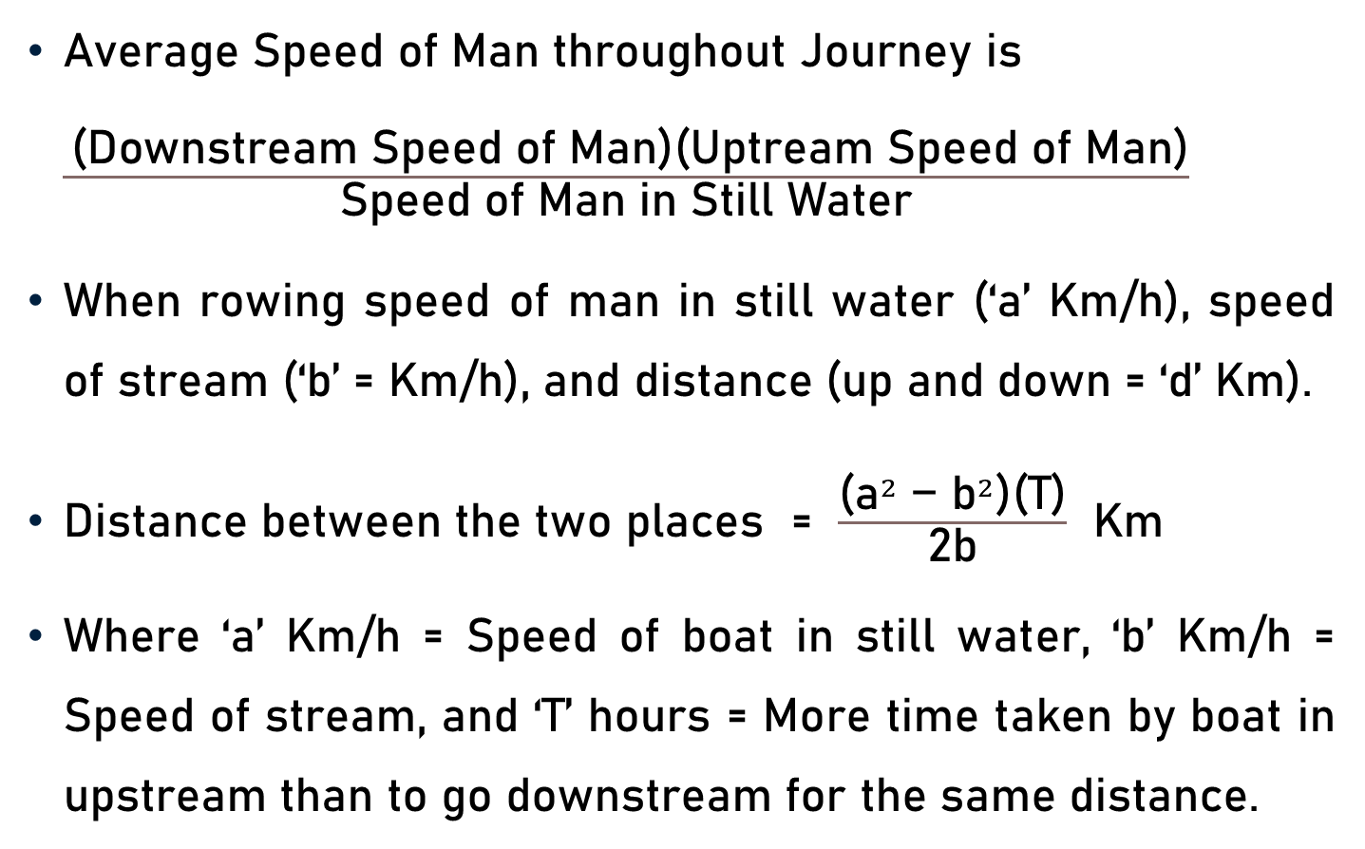
Conclusion
Average Speed of Man throughout Journey is $\frac{ \text{(}\text{Downstream} \text{Speed} \text{of} \text{Man}\text{)(}\text{Uptream} \text{Speed} \text{of} \text{Man}\text{)}}{\text{Speed} \text{of} \text{Man} \text{in} \text{Still} \text{Water}}$
When rowing speed of man in still water (‘a’ Km/h), speed of stream (‘b’ = Km/h), and distance (up and down = ‘d’ Km).
Distance between the two places = $\frac{\text{(}{\text{a}}^{2}\text{ − }{\text{b}}^{2}\text{)}\text{(}\text{T}\text{)}}{\text{2}\text{b}}$ Km
Where ‘a’ Km/h = Speed of boat in still water, ‘b’ Km/h = Speed of stream, and ‘T’ hours = More time taken by boat in upstream than to go downstream for the same distance.

Slide 23
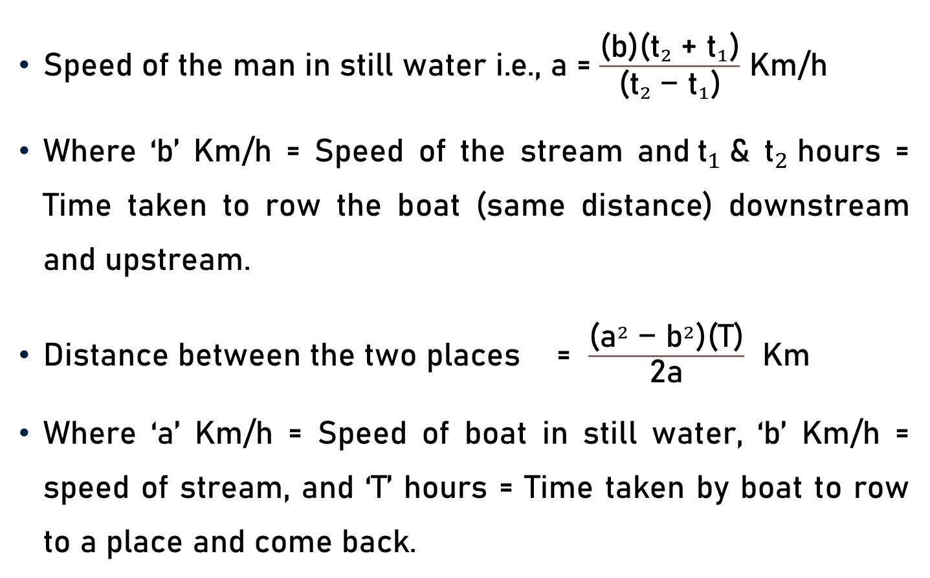
Conclusion
$\text{S}\text{peed} \text{of} \text{the} \text{man} \text{in} \text{still} \text{water} \text{i}\text{.}\text{e}\text{., }\text{a}$= $\frac{\text{(}\text{b}\text{)(}{{\text{t}}_{2} \text{+ }\text{t}}_{1}\text{)}}{\text{(}{{\text{t}}_{2} \text{− }\text{t}}_{1}\text{)}}$ Km/h
Where ‘b’ Km/h = Speed of the stream and${\text{t}}_{1}$& ${\text{t}}_{2}$hours = Time taken to row the boat (same distance) downstream and upstream.
Distance between the two places = $\frac{\text{(}{\text{a}}^{2}\text{ − }{\text{b}}^{2}\text{)}\text{(}\text{T}\text{)}}{\text{2}\text{a}}$ Km
Where ‘a’ Km/h = Speed of boat in still water, ‘b’ Km/h = speed of stream, and ‘T’ hours = Time taken by boat to row to a place and come back.

Slide 24
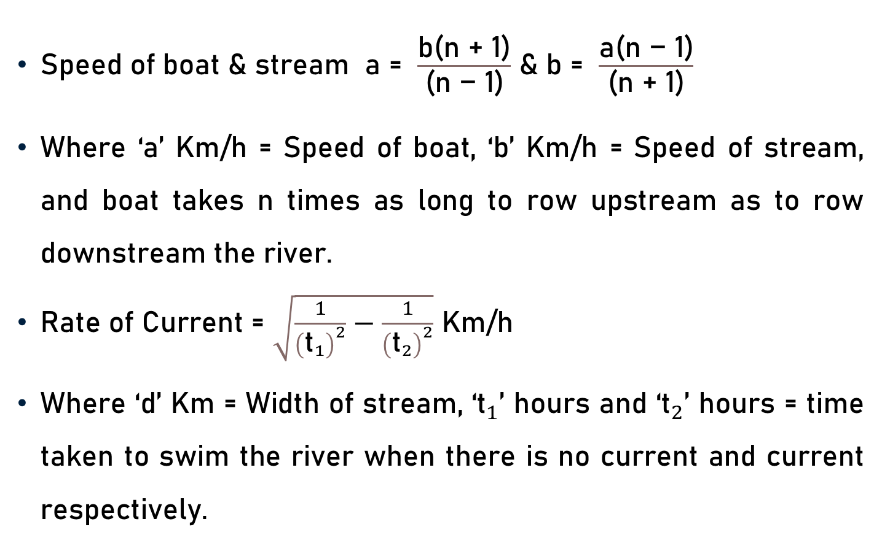
Conclusion
Speed of boat & stream a = $\frac{\text{b}\text{(}\text{n}\text{ + 1}\text{)}}{\text{(}\text{n}\text{ − 1}\text{)}}$ & b = $\frac{\text{a}\text{(}\text{n}\text{ − 1}\text{)}}{\text{(}\text{n}\text{ + 1}\text{)}}$
Where ‘a’ Km/h = Speed of boat, ‘b’ Km/h = Speed of stream, and boat takes n times as long to row upstream as to row downstream the river.
Rate of Current = $\sqrt{\frac{1}{{\left({\text{t}}_{1}\right)}^{2}}−\frac{1}{{\left({\text{t}}_{2}\right)}^{2}}}$ Km/h
Where ‘d’ Km = Width of stream, ‘${\text{t}}_{1}$’ hours and ‘${\text{t}}_{2}$’ hours = time taken to swim the river when there is no current and current respectively.

Slide 25
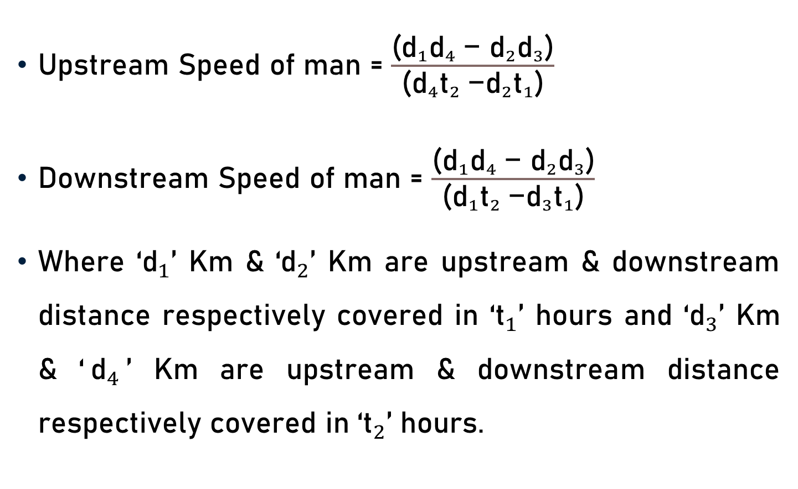
Conclusion
Upstream Speed of man = $\frac{\text{(}{{{\text{d}}_{1}\text{d}}_{4} \text{− }{\text{d}}_{2}\text{d}}_{3}\text{)}}{\text{(}{{{\text{d}}_{4}\text{t}}_{2} \text{−}{\text{d}}_{2}\text{t}}_{1}\text{)}}$
Downstream Speed of man = $\frac{\text{(}{{{\text{d}}_{1}\text{d}}_{4} \text{− }{\text{d}}_{2}\text{d}}_{3}\text{)}}{\text{(}{{{\text{d}}_{1}\text{t}}_{2} \text{−}{\text{d}}_{3}\text{t}}_{1}\text{)}}$
Where ‘${\text{d}}_{1}$’ Km & ‘${\text{d}}_{2}$’ Km are upstream & downstream distance respectively covered in ‘${\text{t}}_{1}$’ hours and ‘${\text{d}}_{3}$’ Km & ‘${\text{d}}_{4}$’ Km are upstream & downstream distance respectively covered in ‘${\text{t}}_{2}$’ hours.

Slide 26
Summary
Problems
  Boats & Streams

